Slide 1


Nevada Marquis

Slide 2
Table of Contents
Executive Summary
Introduction
Methodology
Results
Conclusion
Appendix

Slide 3
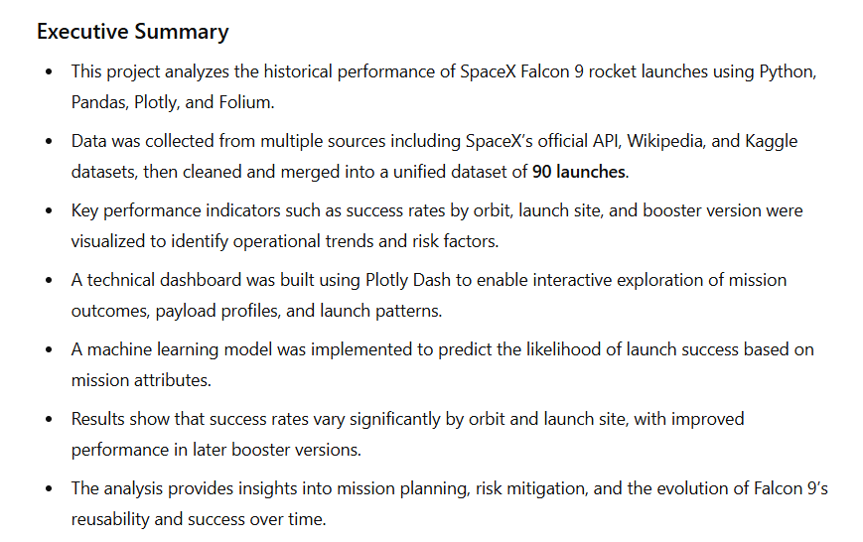

Slide 4

Project Objectives
Understand what factors affect Falcon 9 landing success.
Use data wrangling, visualization, and Folium mapping.
Create dashboards with Plotly and HTML.
Train machine learning models to predict landing success.

Slide 5
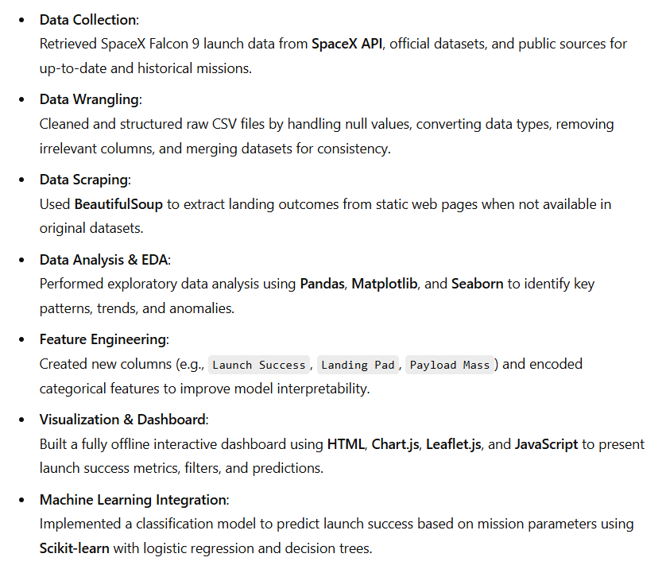
Methodology

Slide 6
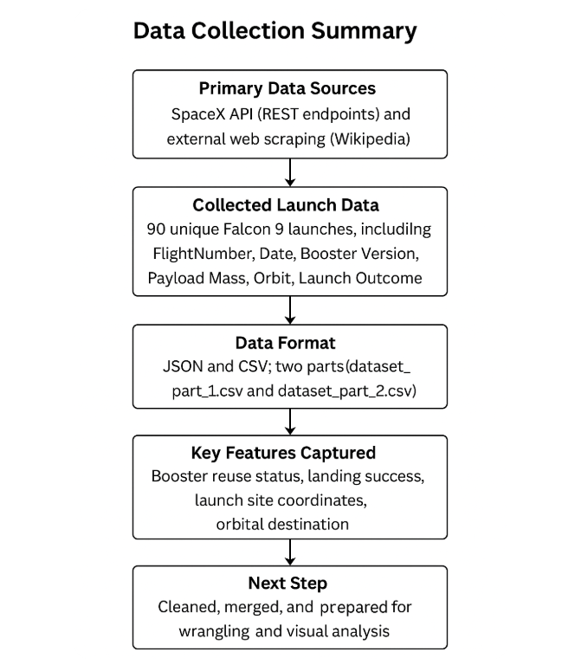
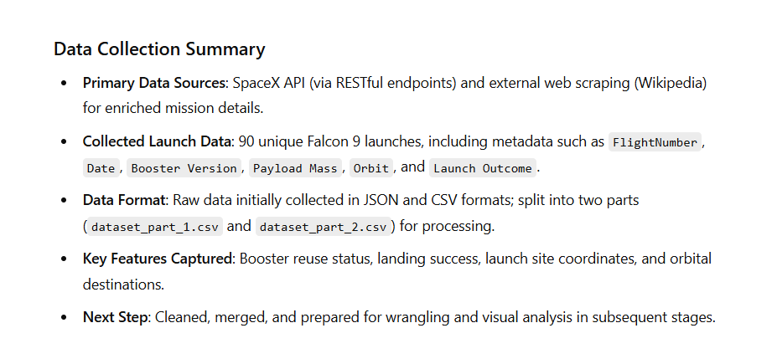
Data Collection – SpaceX API

Slide 7
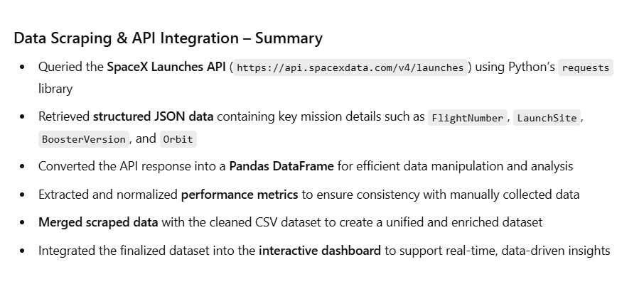
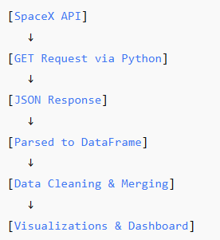
Data Collection - Scraping

Slide 8
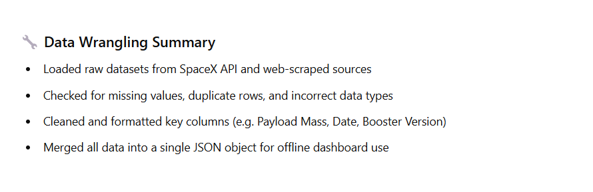
Data Wrangling

Slide 9
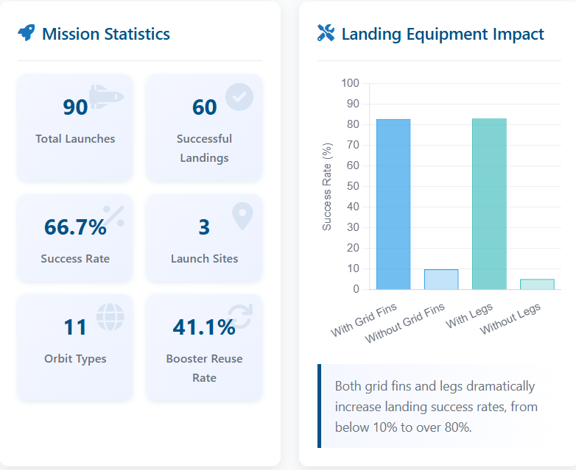
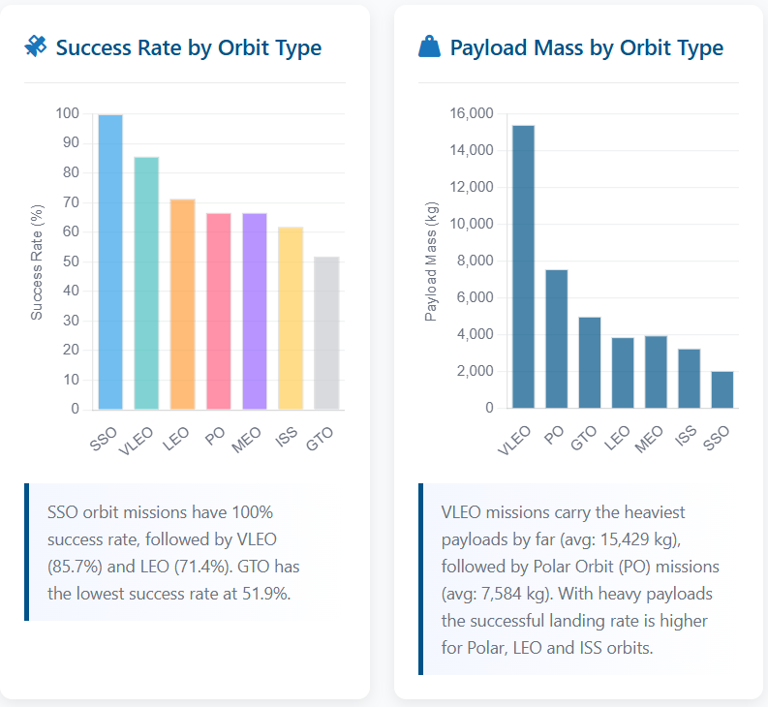
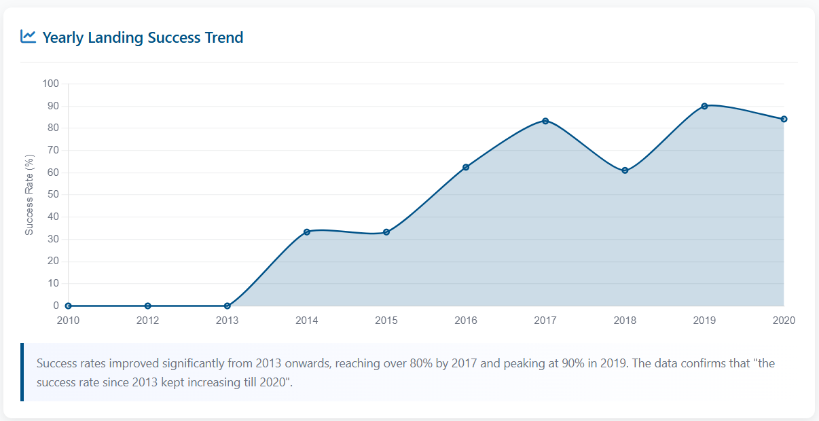
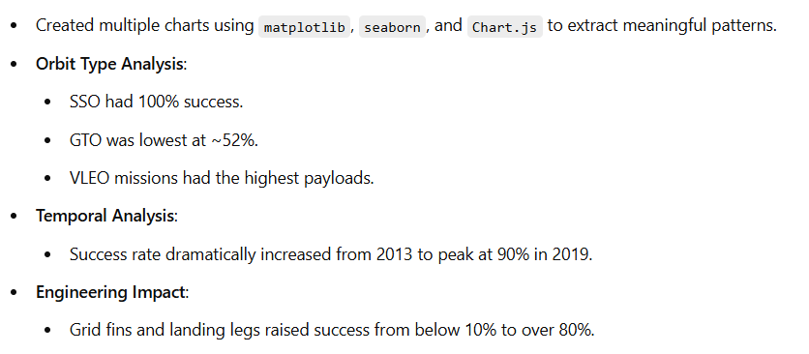
EDA with Data Visualization

Slide 10
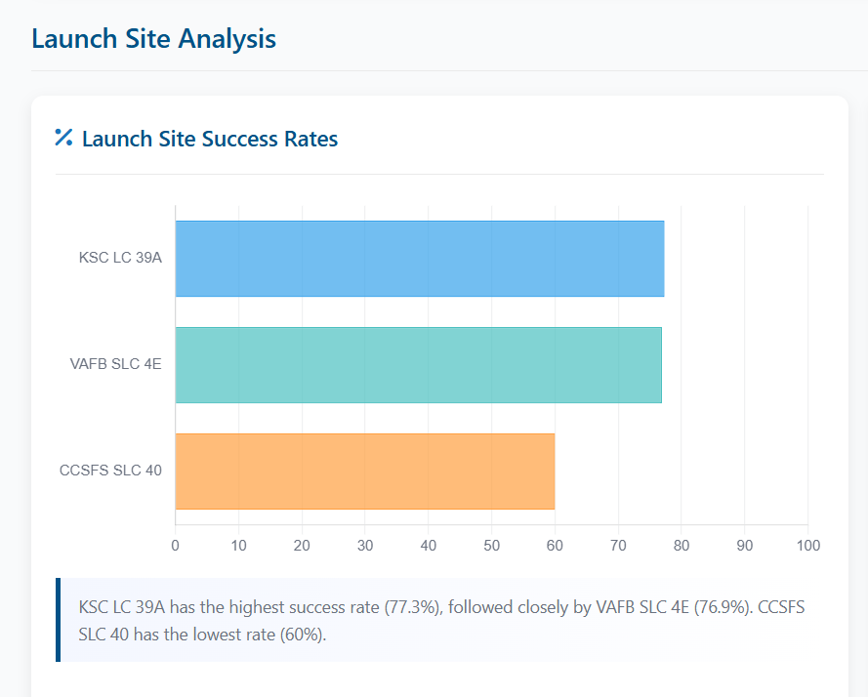
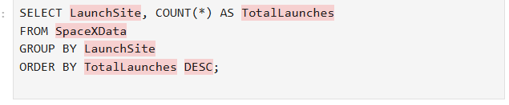
EDA with SQL
SQL Query Summary
Objective: Analyze how many Falcon 9 launches occurred at each launch site.
SQL Query Used:
Steps Taken:
Queried the full SpaceX dataset for launch information.
Grouped data by LaunchSite to aggregate all launches per location.
Counted total launches for each site using COUNT(*).
Ordered results in descending order to highlight the most active launch sites.
Insights Gained:
Identified the most frequently used launch locations.
Provided a foundation to assess site-specific success rates and trends.

Slide 11
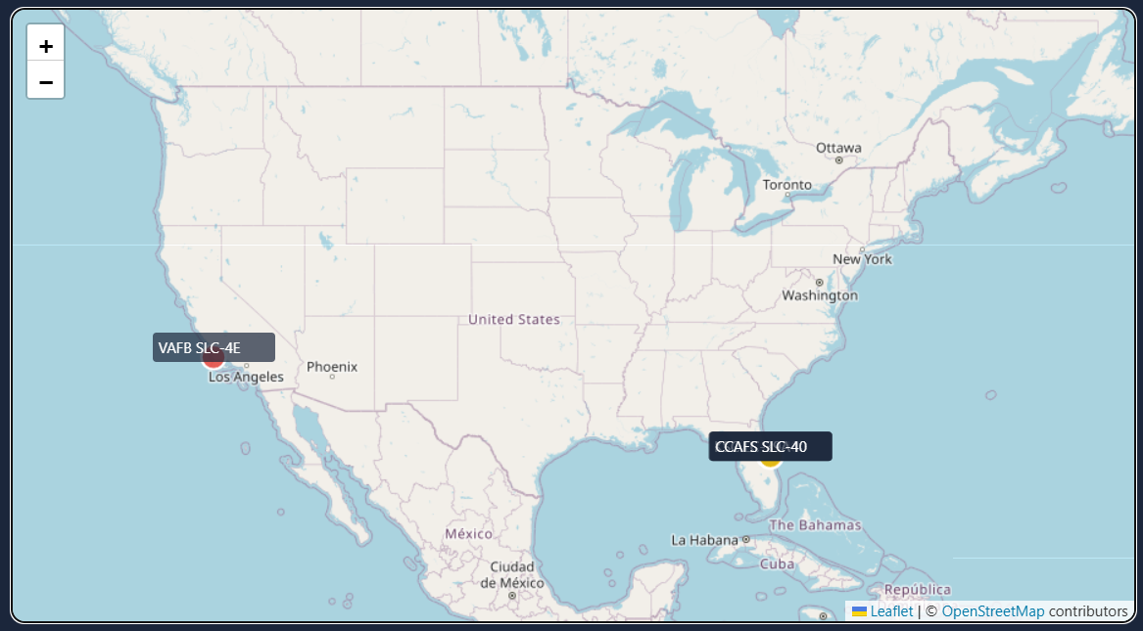
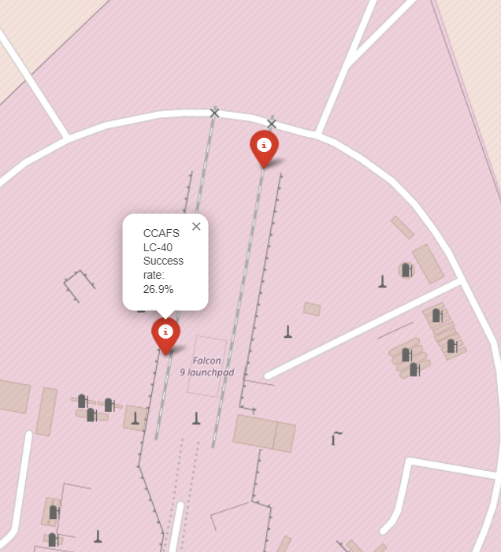
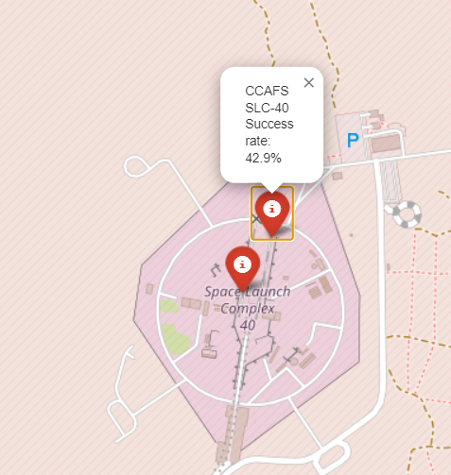
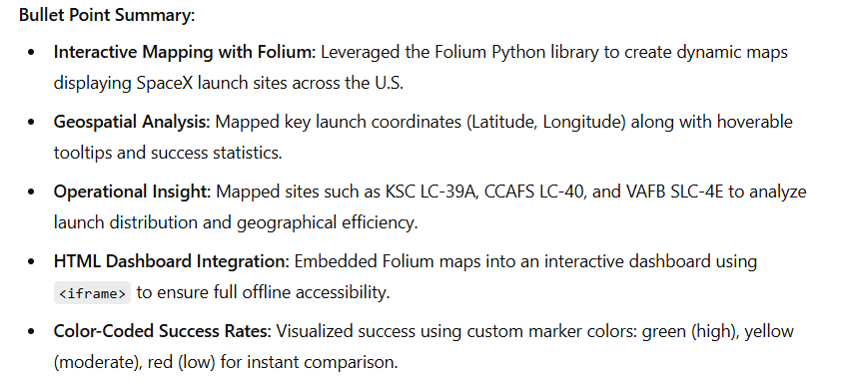
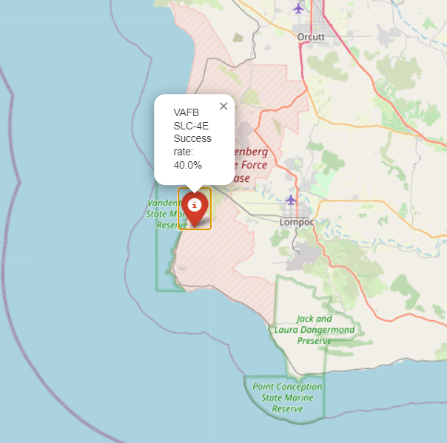
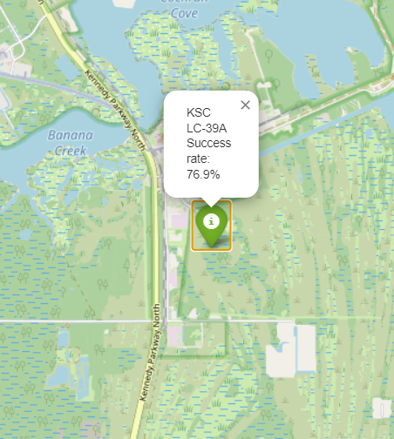

Slide 12
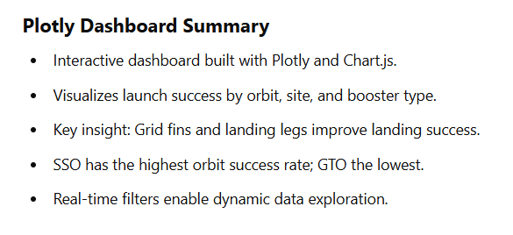
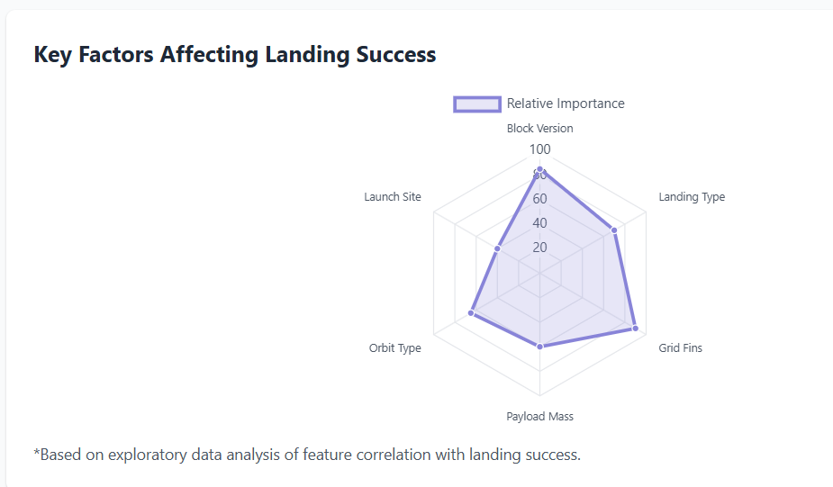
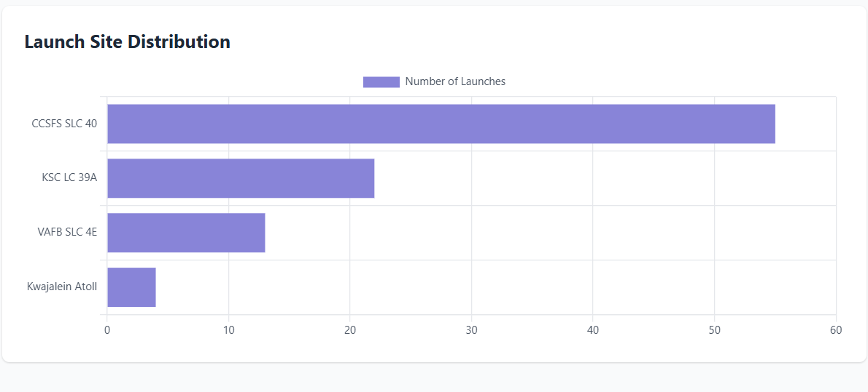
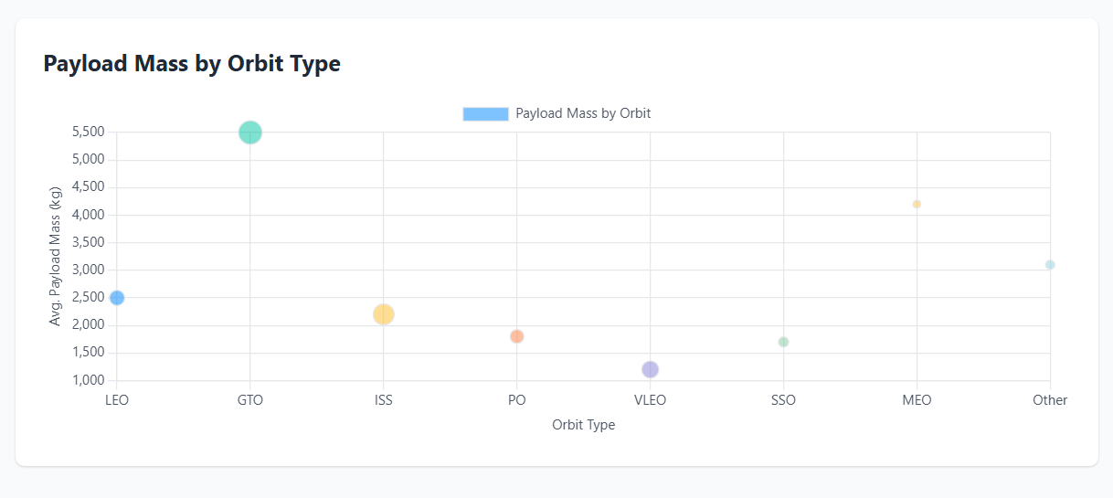

Slide 13
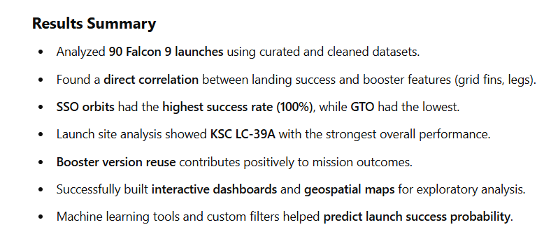

Slide 14
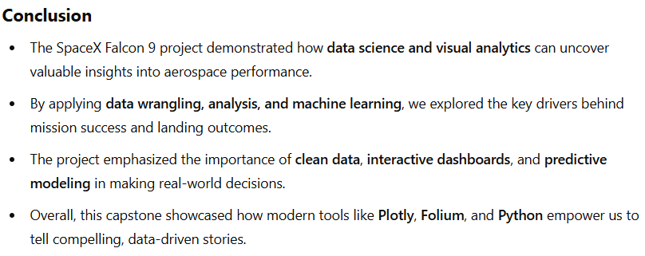

Slide 15
